Slide 1



BFX-AT100
3rd Mass production Cosmetic inspection
SB PARK
Model Name: BFX-AT100
Document Version: ALT_STB_MP_CSMTINS_002
Issued Date: 2019.09.25

Slide 2
Document History
Version | Editor | Date | Updates
001 | SB PARK (Seongbae Park) | 2019.09.25 | initial version

Slide 3
Summary
SKB cosmetic inspection
  Inspection lot : 3rd MP 50,000pcs
    Sampling size : AQL 0.15 (500pcs)
  Date : 2019.09.20 ~ 2019.09.30
  Location : SK networks warehouse, Anseong, Korea.
Overall
  As a 500 sampling inspection results, Housing quality improved compare to last 9K production. (Not steam mark and brightness of B logo, but scratch )
Defect Total (TBD)

Slide 4
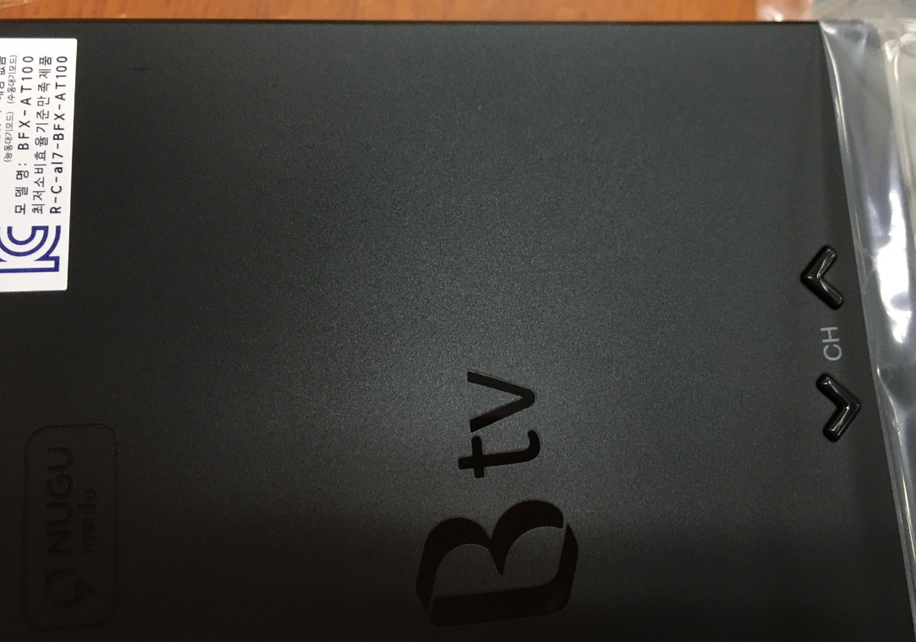
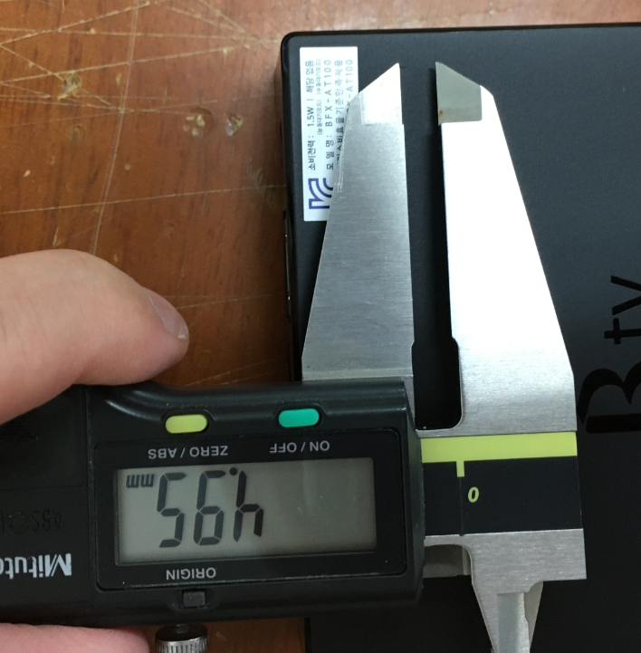
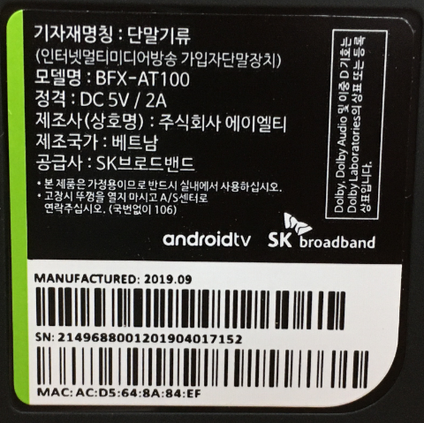
Top housing defect
Scratched on the Top housing
  Defect Q’ty : TBD
  Defect rate : TBD

Slide 5
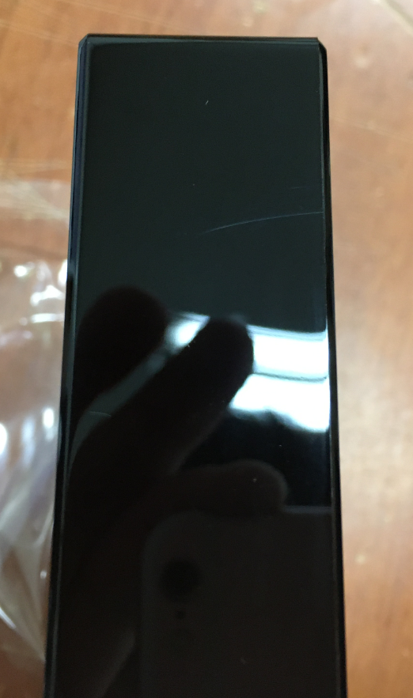
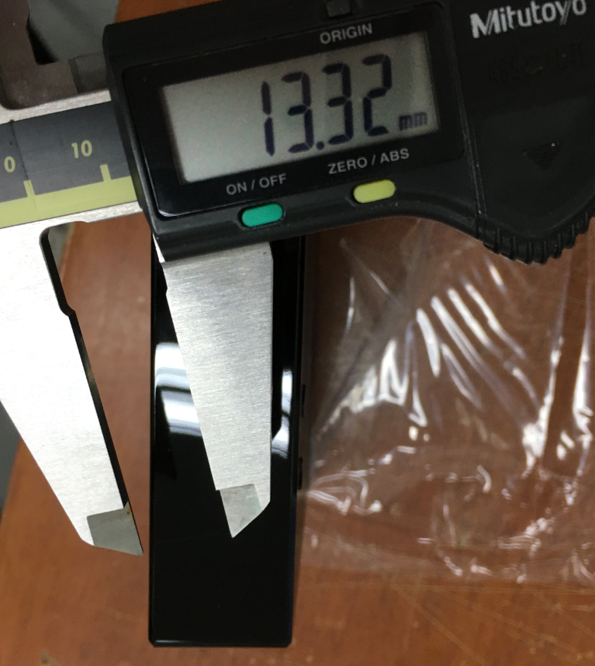
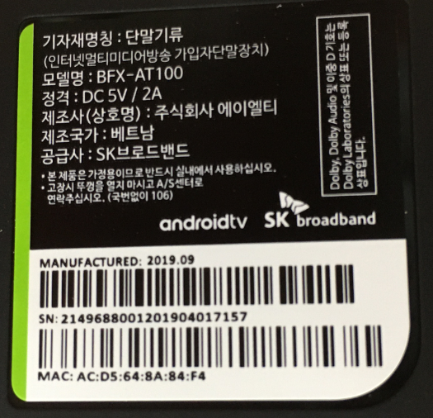
Top housing defect
Scratched on the Top housing
  Defect Q’ty : TBD
  Defect rate : TBD

Slide 6
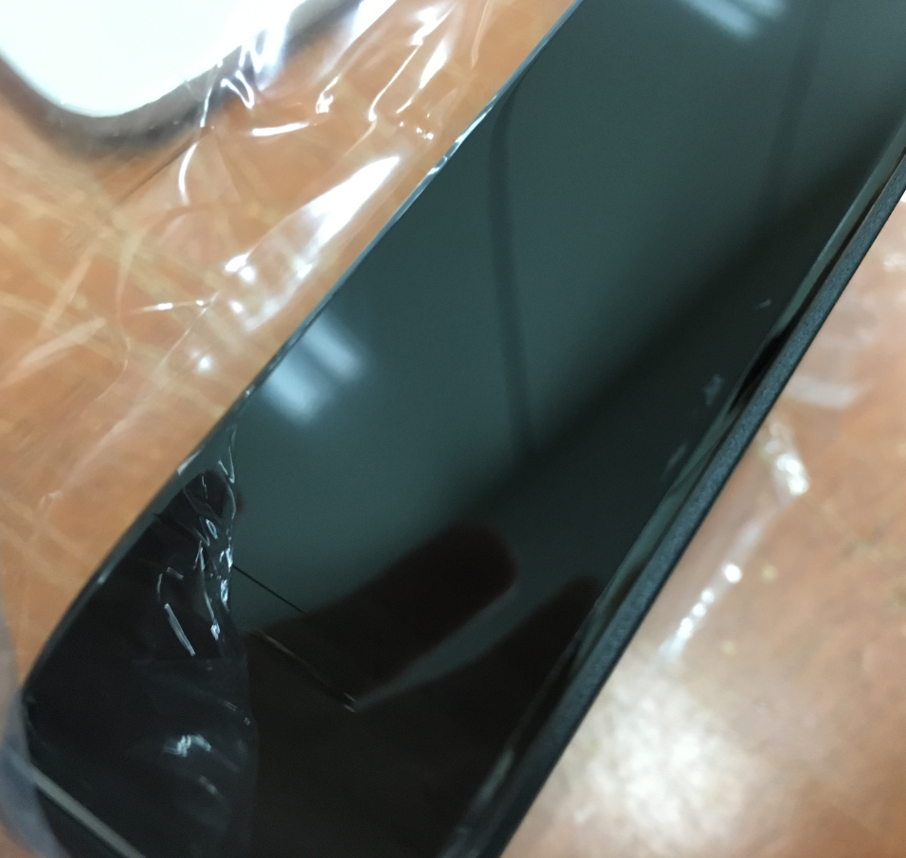
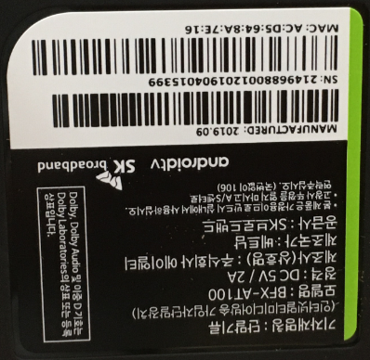
Top housing defect
Scratched on the Top housing
  Defect Q’ty : TBD
  Defect rate : TBD

Slide 7
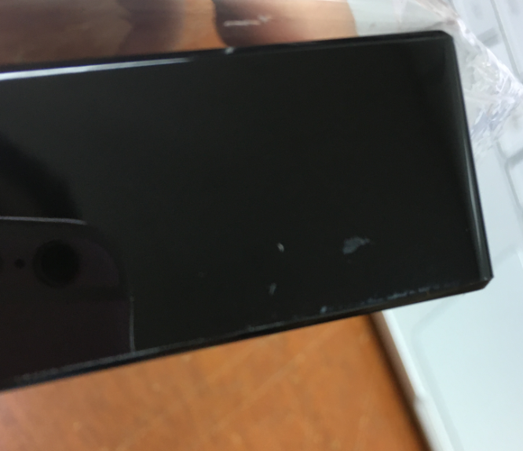
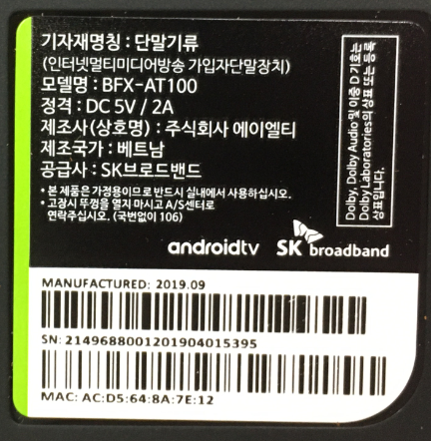
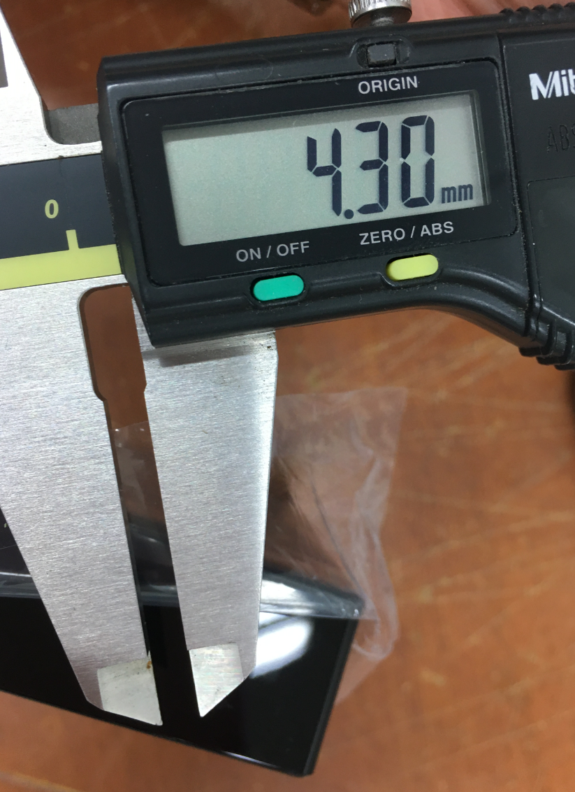
Top housing defect
Scratched on the Top housing
  Defect Q’ty : TBD
  Defect rate : TBD

Slide 8
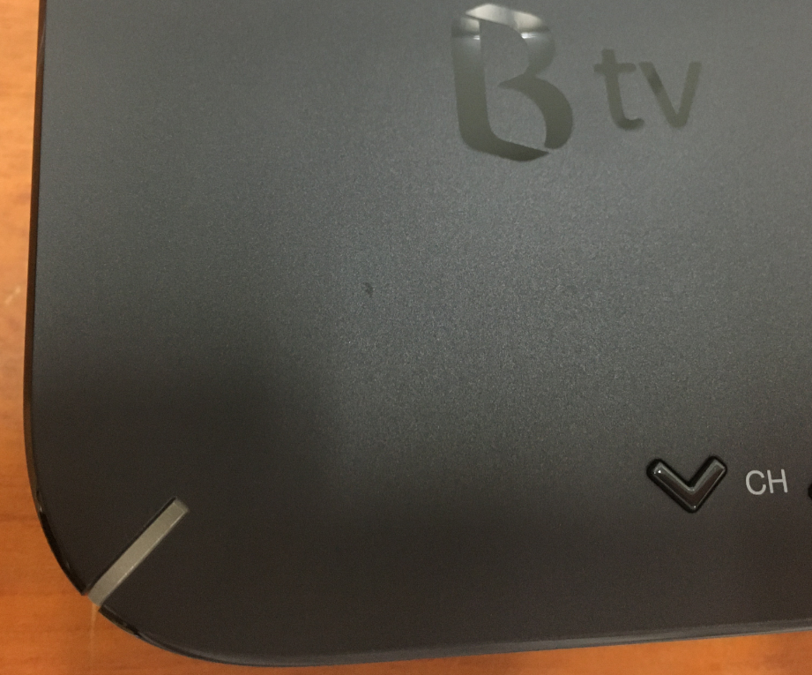
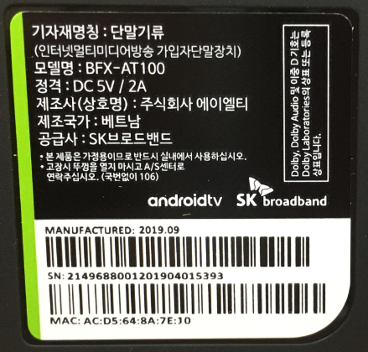
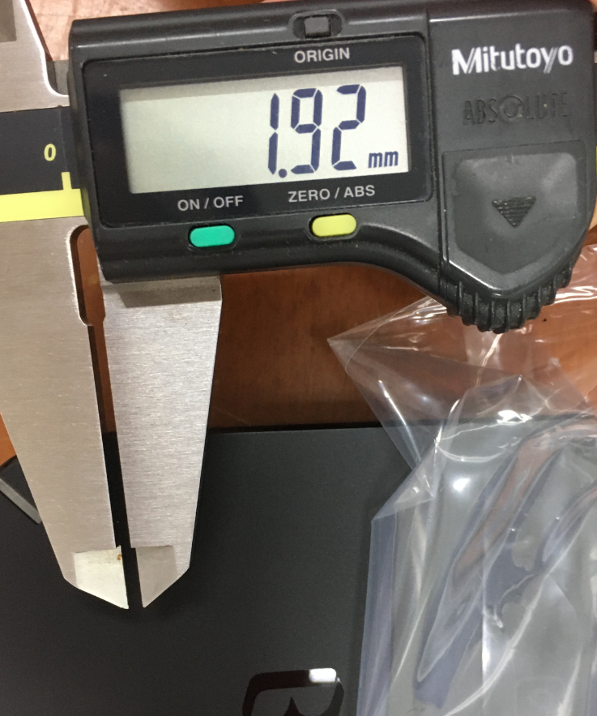
Top housing defect
Scratched on the Top housing
  Defect Q’ty : TBD
  Defect rate : TBD

Slide 9
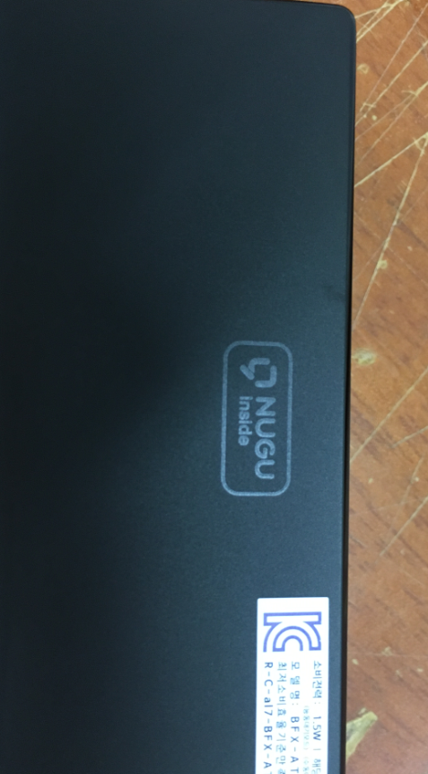
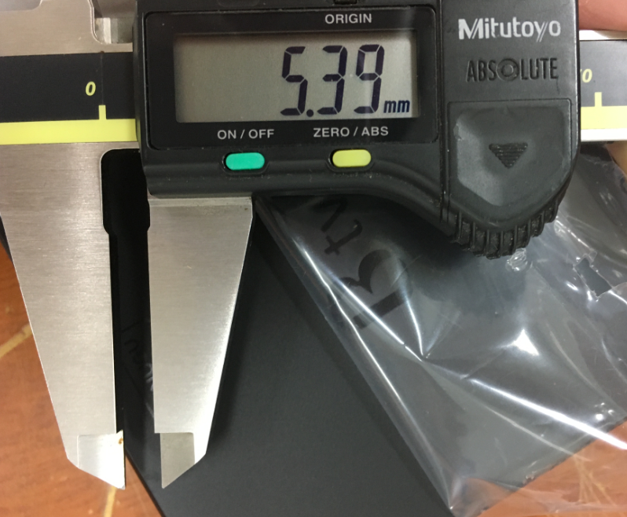
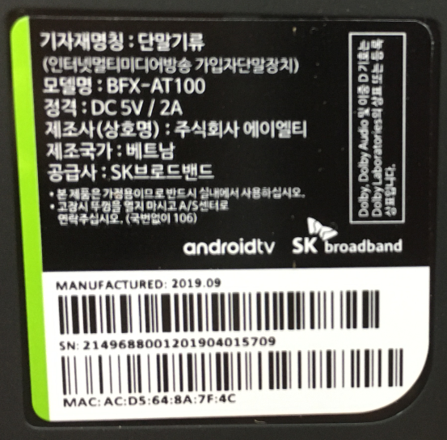
Top housing defect
Scratched on the Top housing
  Defect Q’ty : TBD
  Defect rate : TBD

Slide 10
Top housing defect
Scratched on the Top housing
  Defect Q’ty : TBD
  Defect rate : TBD

Slide 11
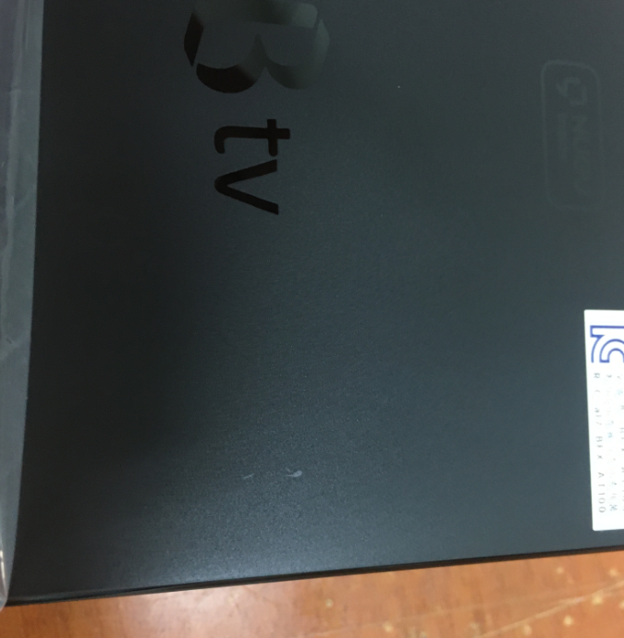
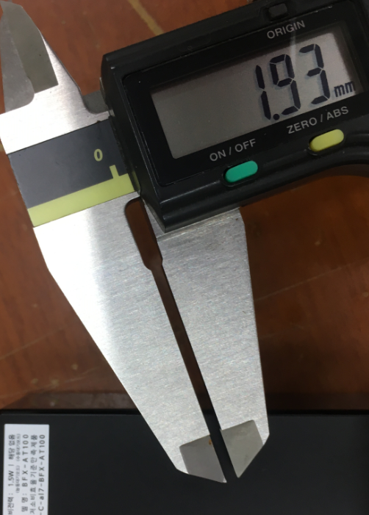
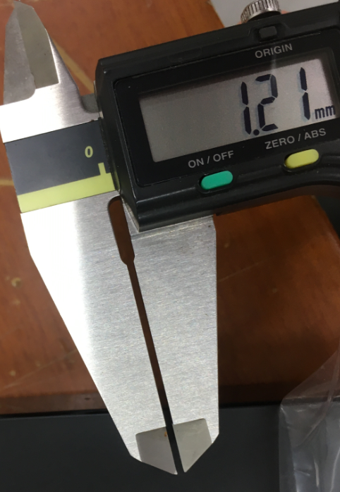
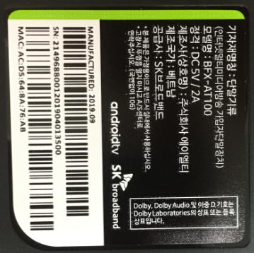
Top housing defect
Scratched on the Top housing
  Defect Q’ty : TBD
  Defect rate : TBD

Slide 12
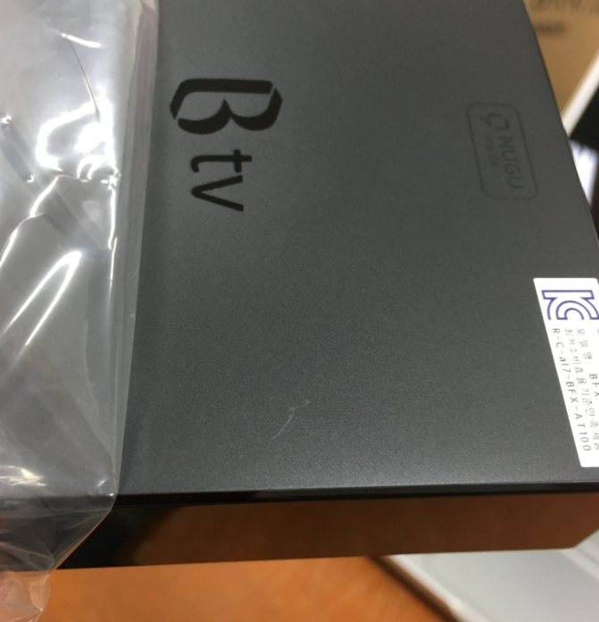
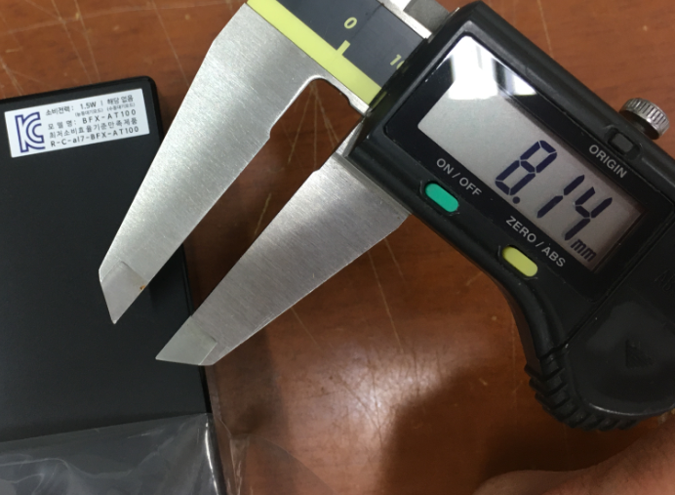
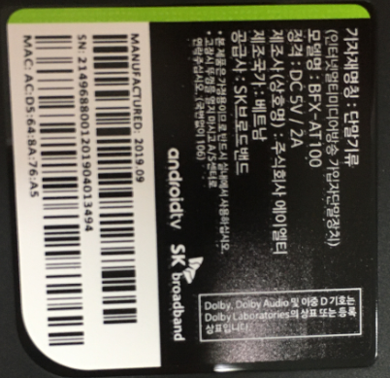
Top housing defect
Scratched on the Top housing
  Defect Q’ty : TBD
  Defect rate : TBD

Slide 13
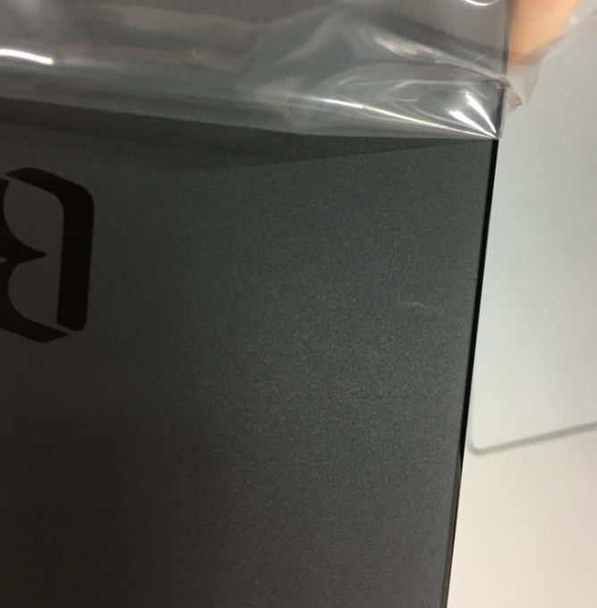
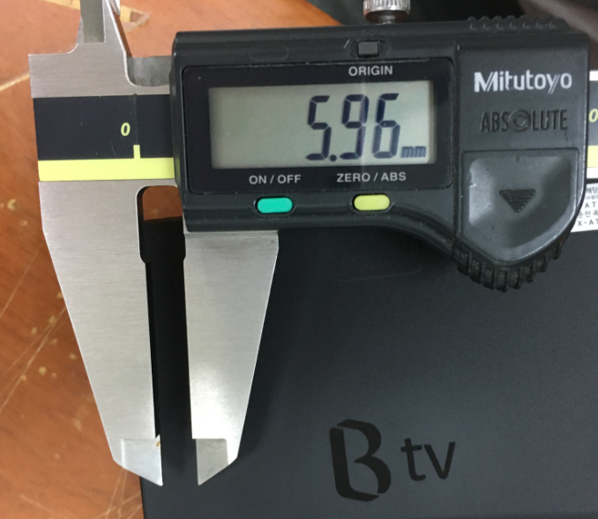
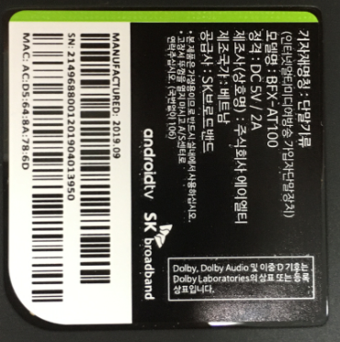
Top housing defect
Scratched on the Top housing
  Defect Q’ty : TBD
  Defect rate : TBD

Slide 14
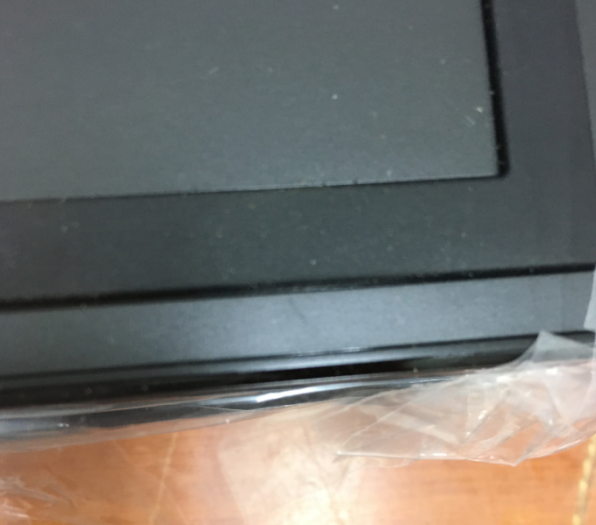
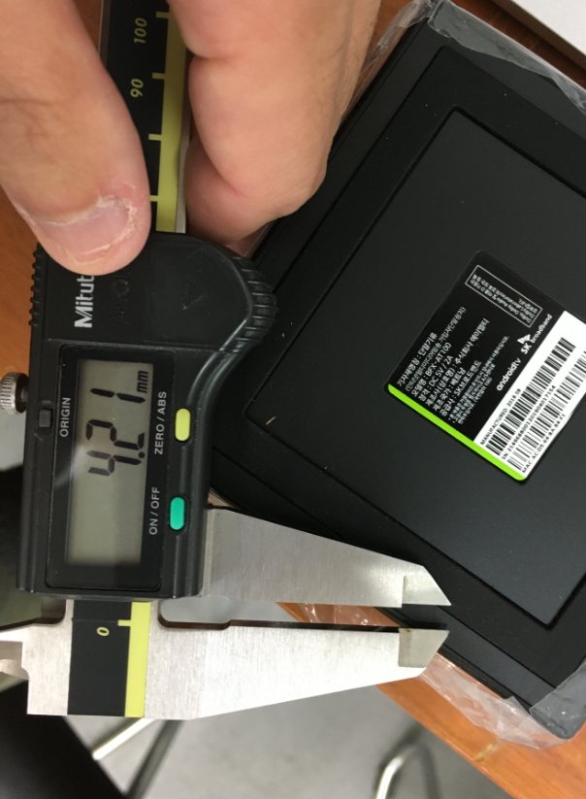
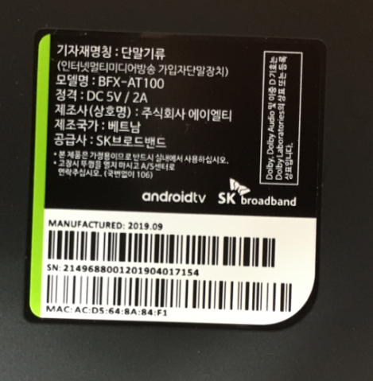
Bottom cover defect
Scratched on Bottom cover
  Defect Q’ty : TBD
  Defect rate : TBD

Slide 15
Bottom cover defect
Scratched on Bottom cover
  Defect Q’ty : TBD
  Defect rate : TBD

Slide 16
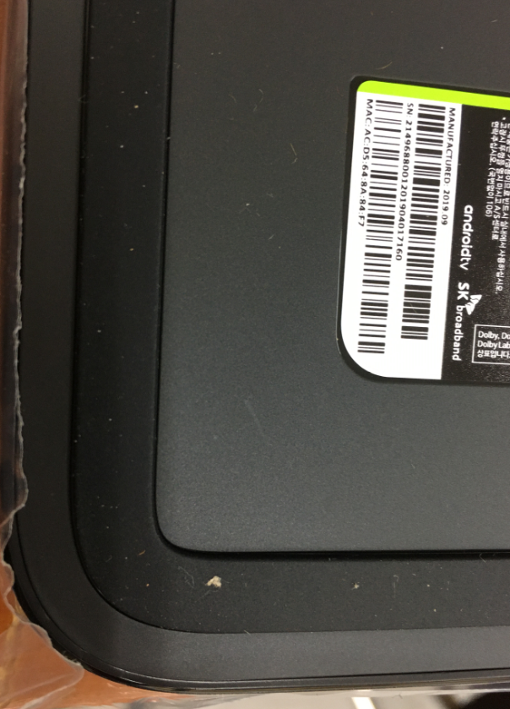
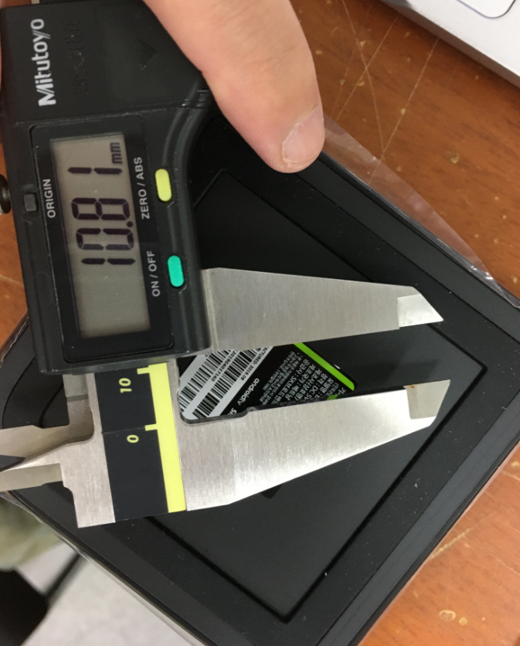
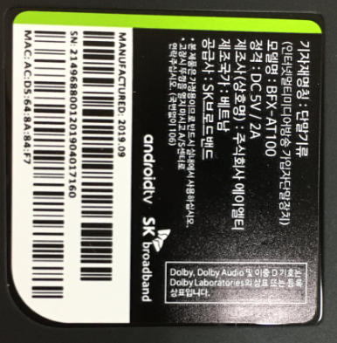
Bottom cover defect
Scratched on Bottom cover
  Defect Q’ty : TBD
  Defect rate : TBD

Slide 17
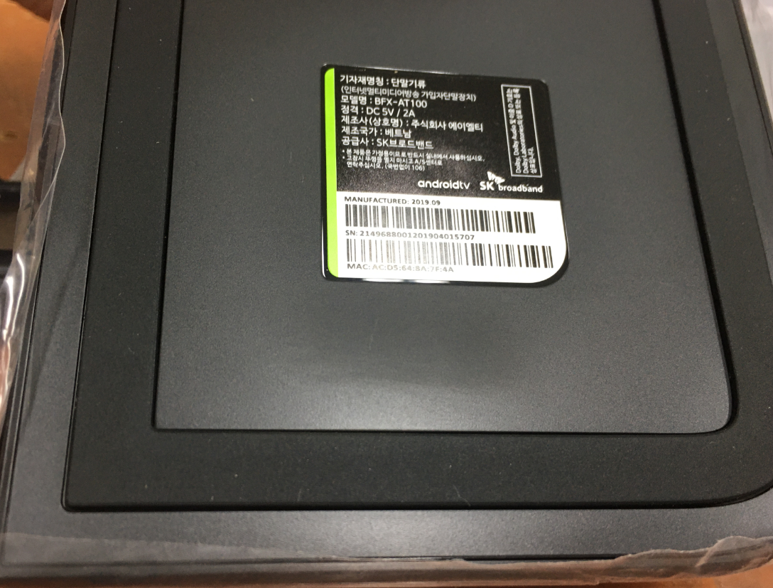
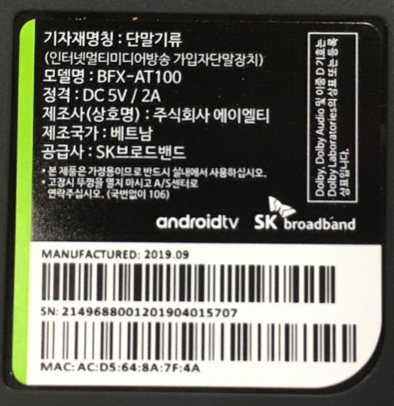
Bottom cover defect
Scratched on Bottom cover
  Defect Q’ty : TBD
  Defect rate : TBD

Slide 18
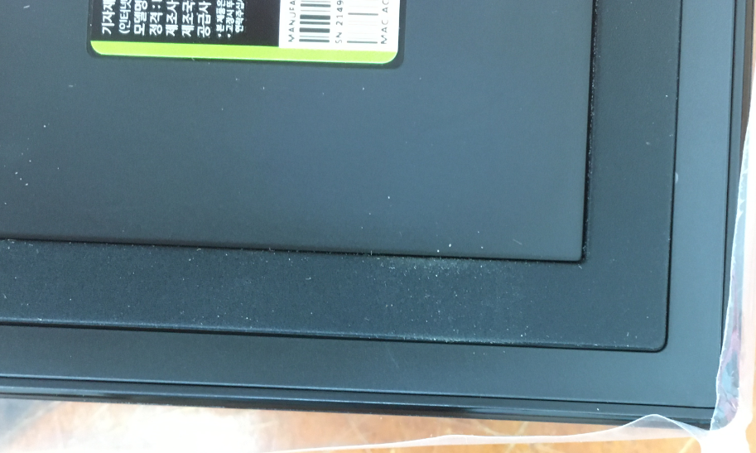
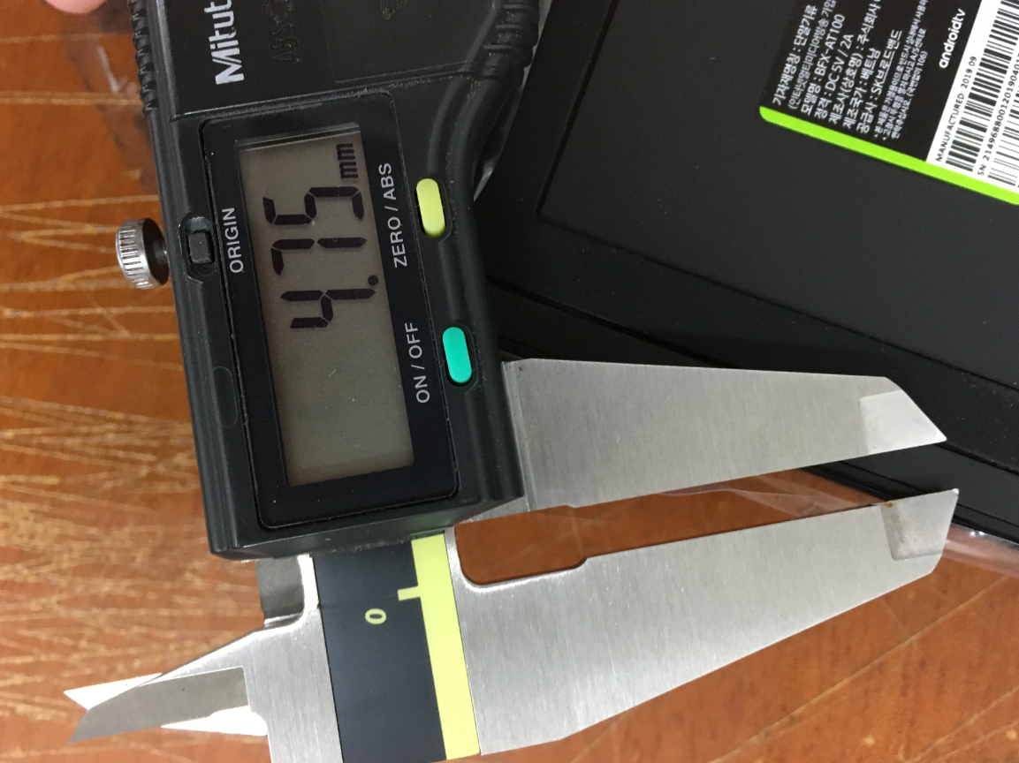
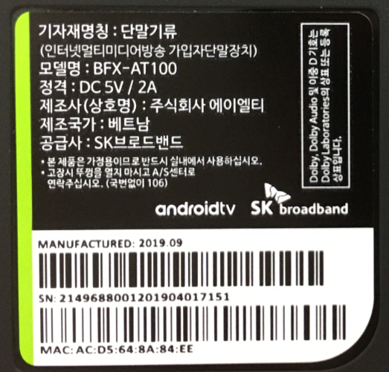
Bottom cover defect
Scratched on Bottom cover
  Defect Q’ty : TBD
  Defect rate : TBD

Slide 19
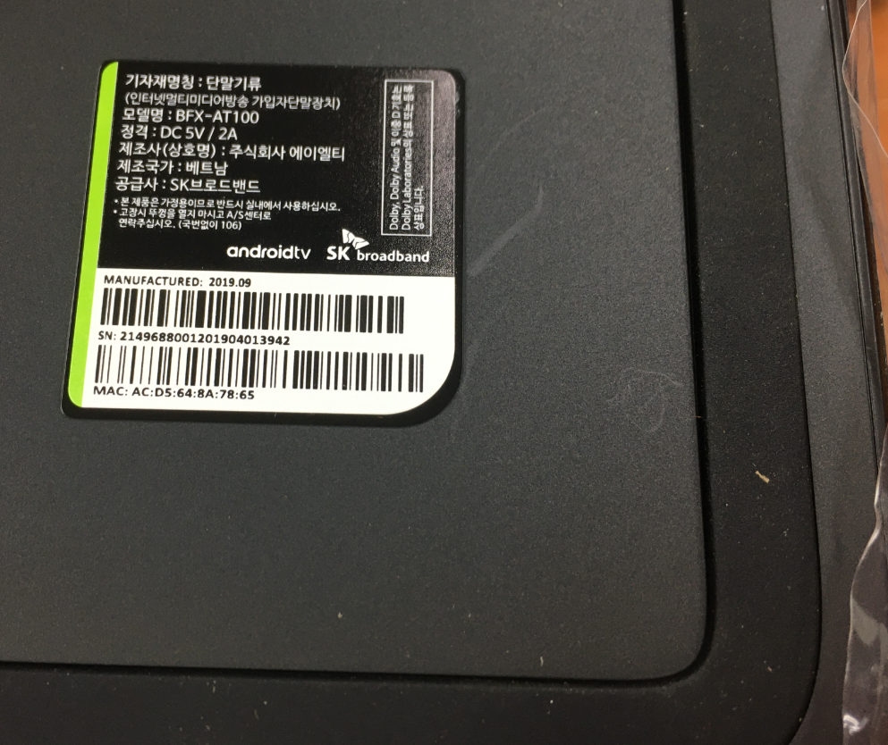
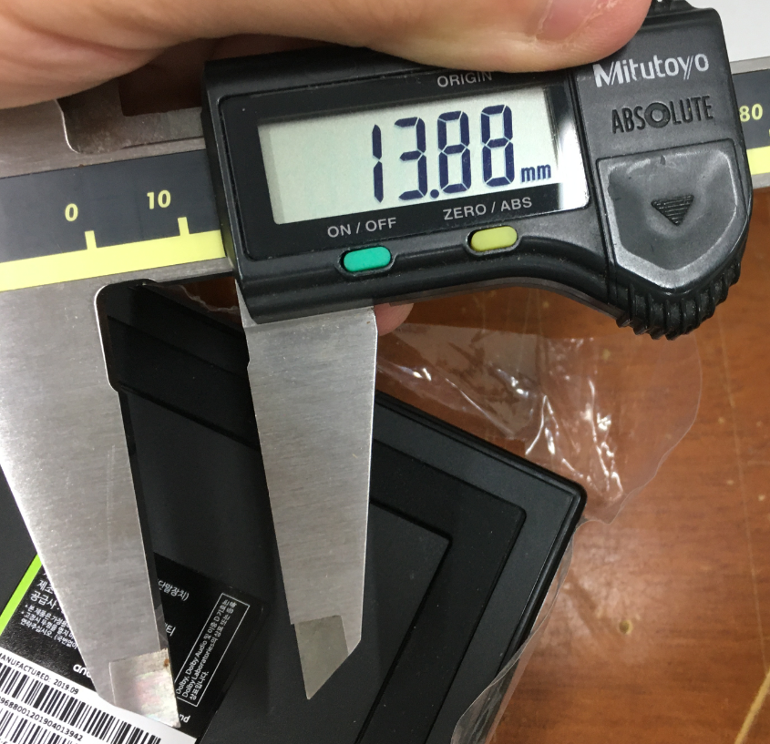
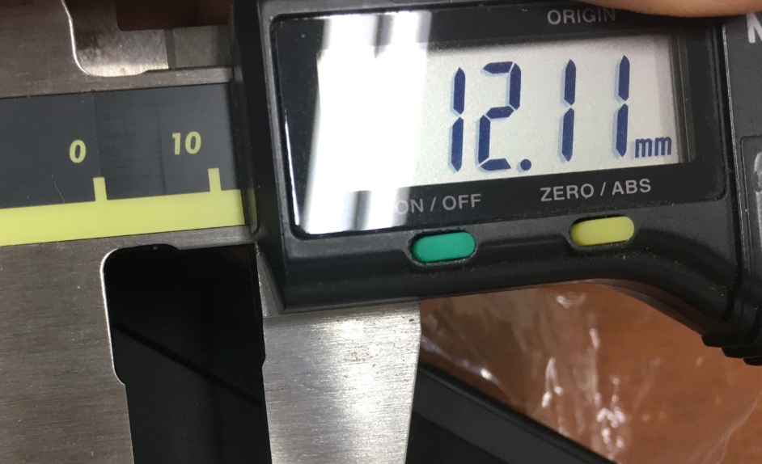
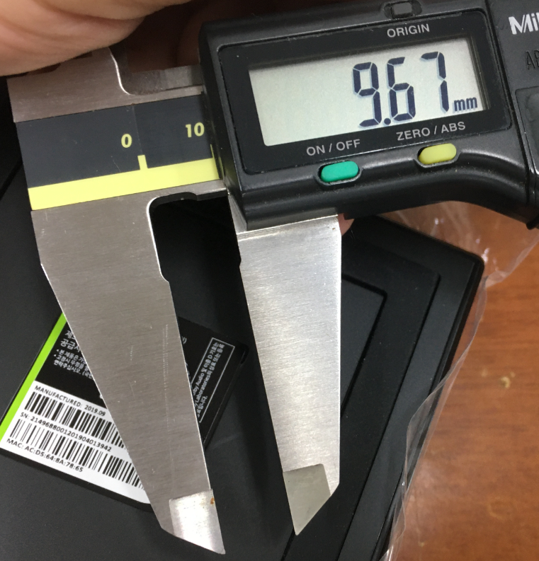
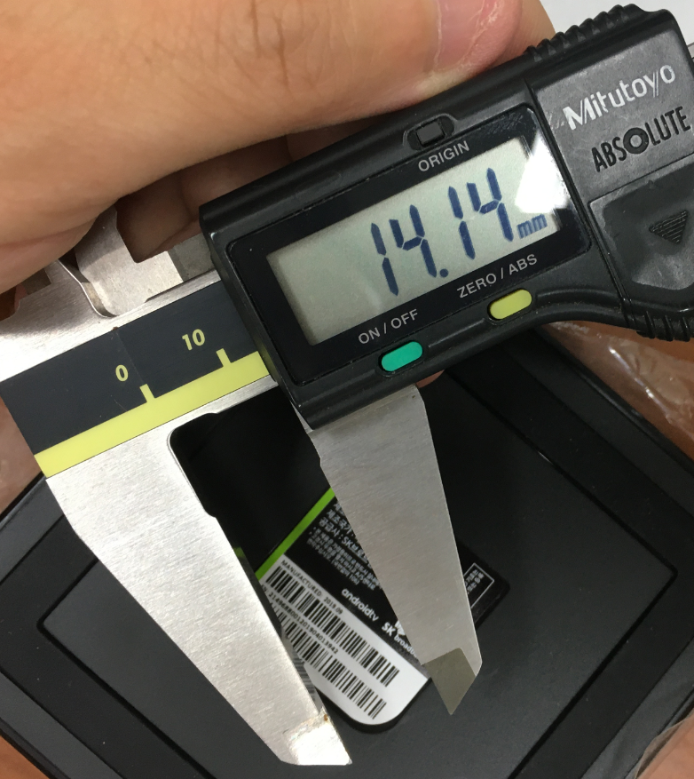
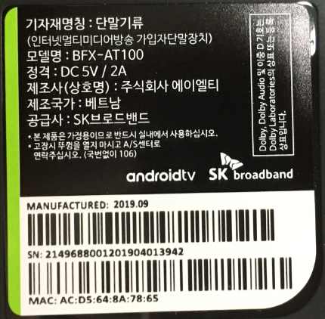
Bottom cover defect
Scratched on Bottom cover
  Defect Q’ty : TBD
  Defect rate : TBD

Slide 20
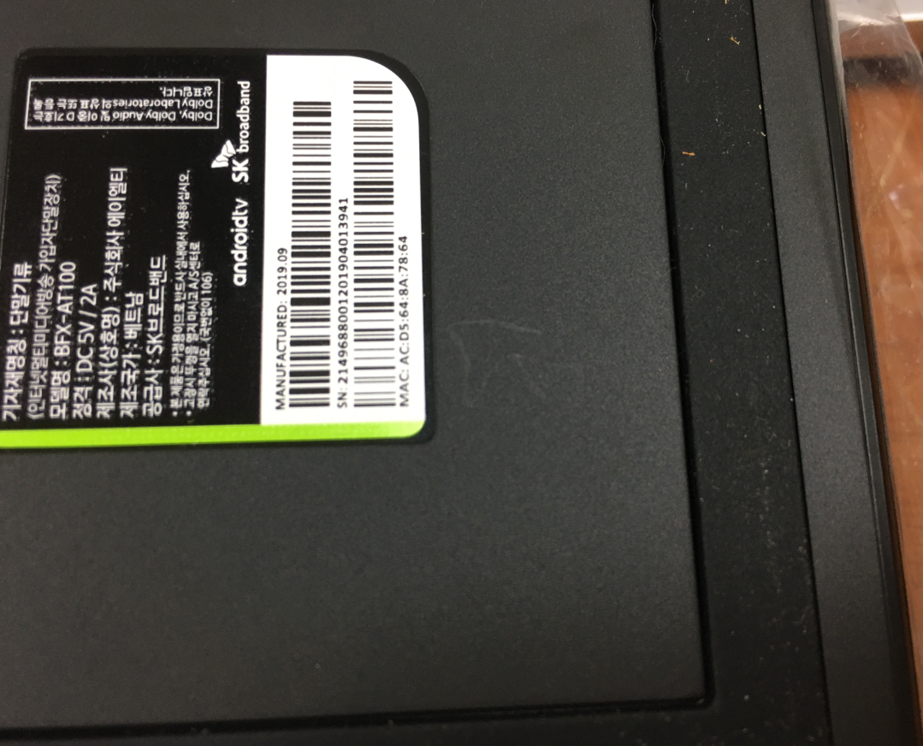
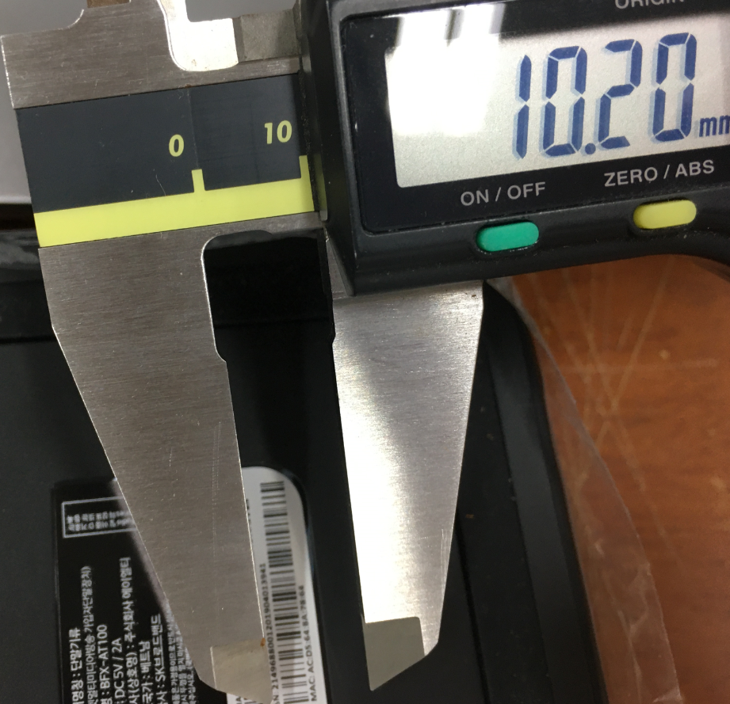
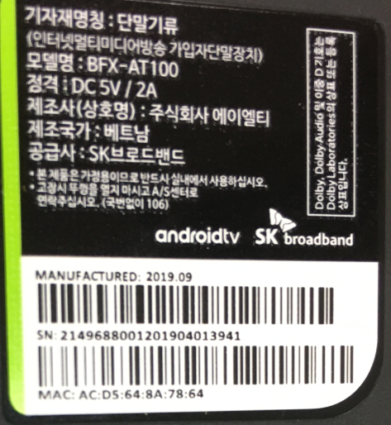
Bottom cover defect
Scratched on Bottom cover
  Defect Q’ty : TBD
  Defect rate : TBD

Slide 21
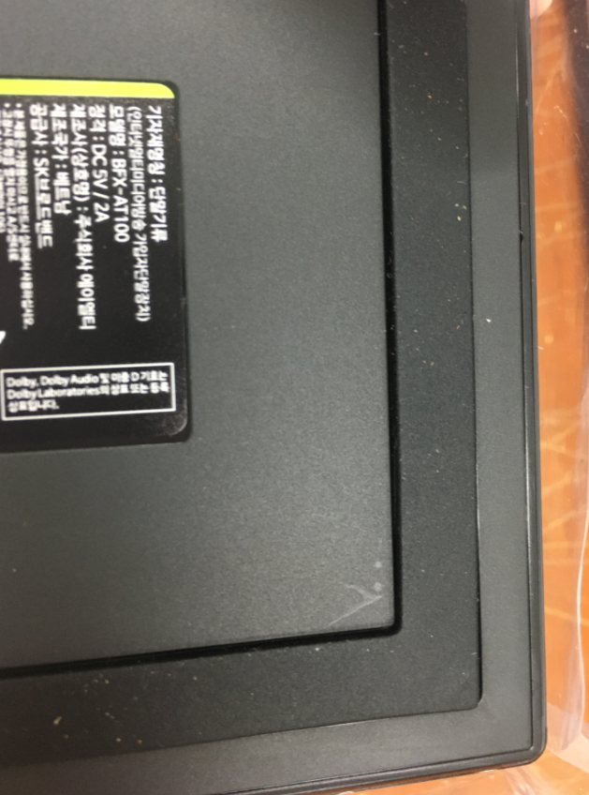
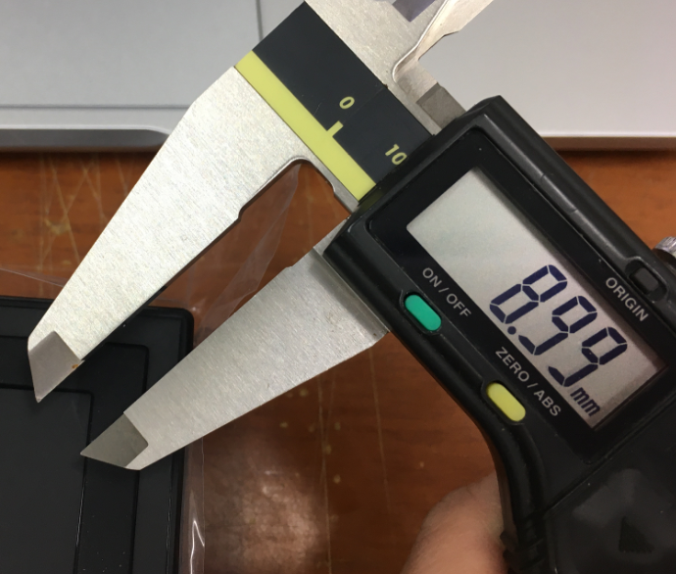
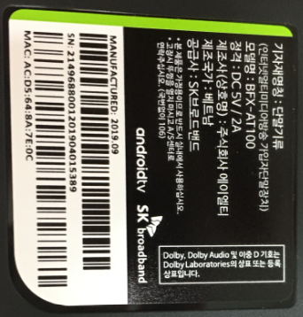
Bottom cover defect
Scratched on Bottom cover
  Defect Q’ty : TBD
  Defect rate : TBD

Slide 22



Bottom cover defect
Scratched on Bottom cover
  Defect Q’ty : TBD
  Defect rate : TBD

Slide 23


Gift box defect
Plastic pack is missing inside gift box
  S/N : 2149688001201904025665
  Defect carton Q’ty : 1pcs / 500pcs
  Defect rate : TBD

Slide 24


Carton box defect
Cushion carton sheet (Top) is missing inside carton box
  Carton ID : 214CUL69350154
  Defect carton Q’ty : 1pcs / 500pcs
  Defect rate : TBD

Slide 25
Top housing steam mark
Housing bad steam mark
The Condition is similar compared to previous MP
( For this reason, no photos are attached )

Slide 26
Top housing steam mark
Brightness around B logo
The Condition is similar compared to previous MP
( For this reason, no photos are attached )

Slide 27

Thank you.

